Slide 1
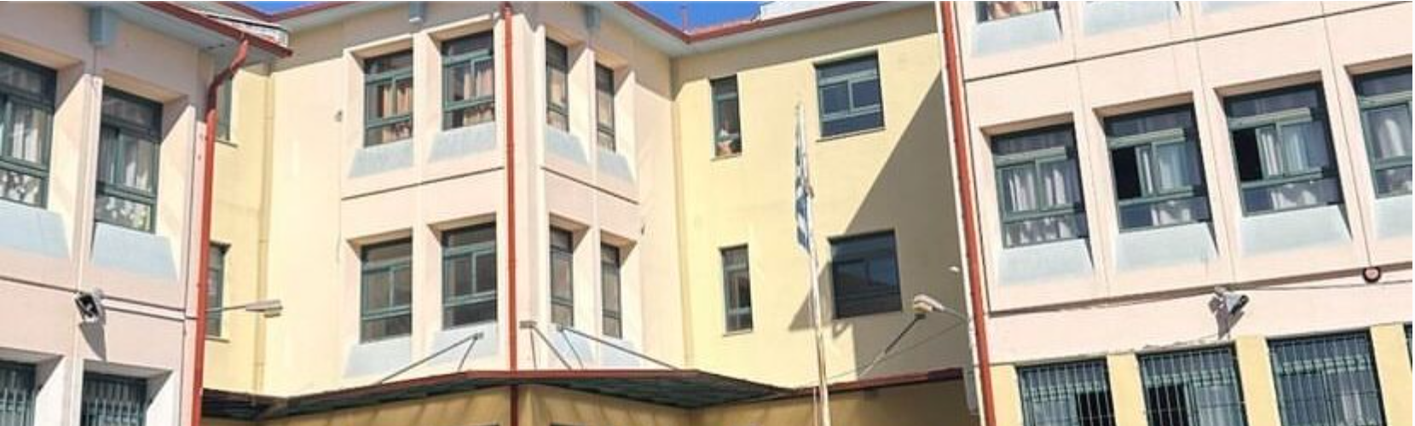
1
The second primary school of pefka

Slide 2
introduction
The name of the school is the 2nd elementary school of pefka
In greek δευτερο δημοτικο σχολειο πευκων
And in greeklish deftero dimotiko sxolio pefkon
It is located in greece,pefka(retziki)
It is right next to the 4th elementary school of pefka and a kindergarden
It has been active since 2004 (22 years)

Slide 3
The building and the halls
The school has 14 rooms which include a gym,a music room which is in construction,a kitchen,4 bathrooms(2 for boys,2 for girls),a library, an English classroom, a computer room and an art classroom!
On the outside it has some big trees a basketball court and a tap for kids to drink water

Slide 4
people of the school
The principal: Mr Kostantinos Kapeleris(for 3,5 years)
The teachers
The english teacher: Ms Bountoulousi Ierofili/Vili(has been here for 1 year but was here 4 years ago)
The art teacher: Mr Simopulos Marios (has been here for 2 years)
The music teacher: Ms Galina(has been here for 2 years)
The PE teacher: Mr Kyriakos
The cleaners:multiple of them

Slide 5
Events and SCHOOL CLUBS
Events:
Every year the school hosts 2 events one for dressing up in costumes for carnival and one to farewell the 6th graders that are going to high school next year
School clubs:
There is only one school club, the drama club, in which only the fifth and sixth graders can participate.

Slide 6
The role of the principal
The role of the principal is to ensure that the school operates according to the program and regulations that are required by law, resolves problems and addresses crisis. His goal is for the school to be a safe space where all students can express themselves, create and learn.

Slide 7
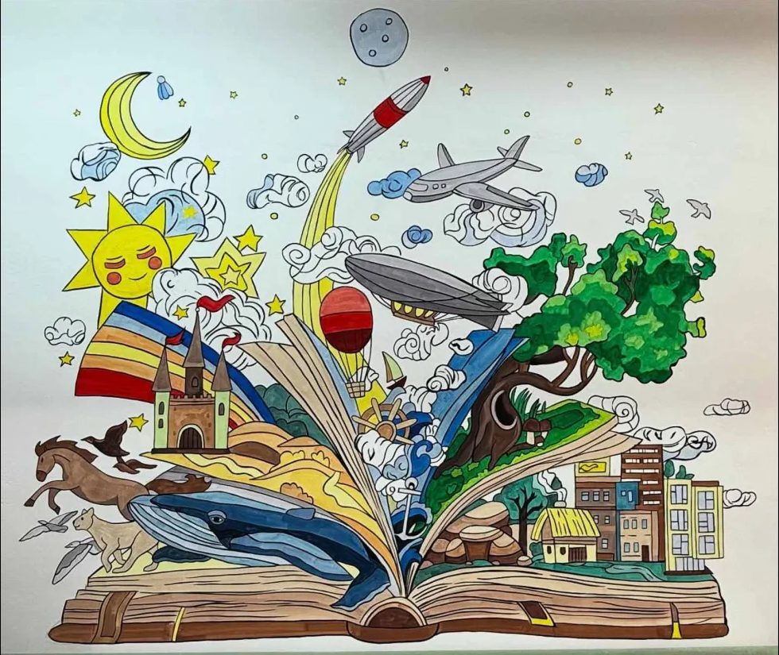
A drawing of the library

Slide 8

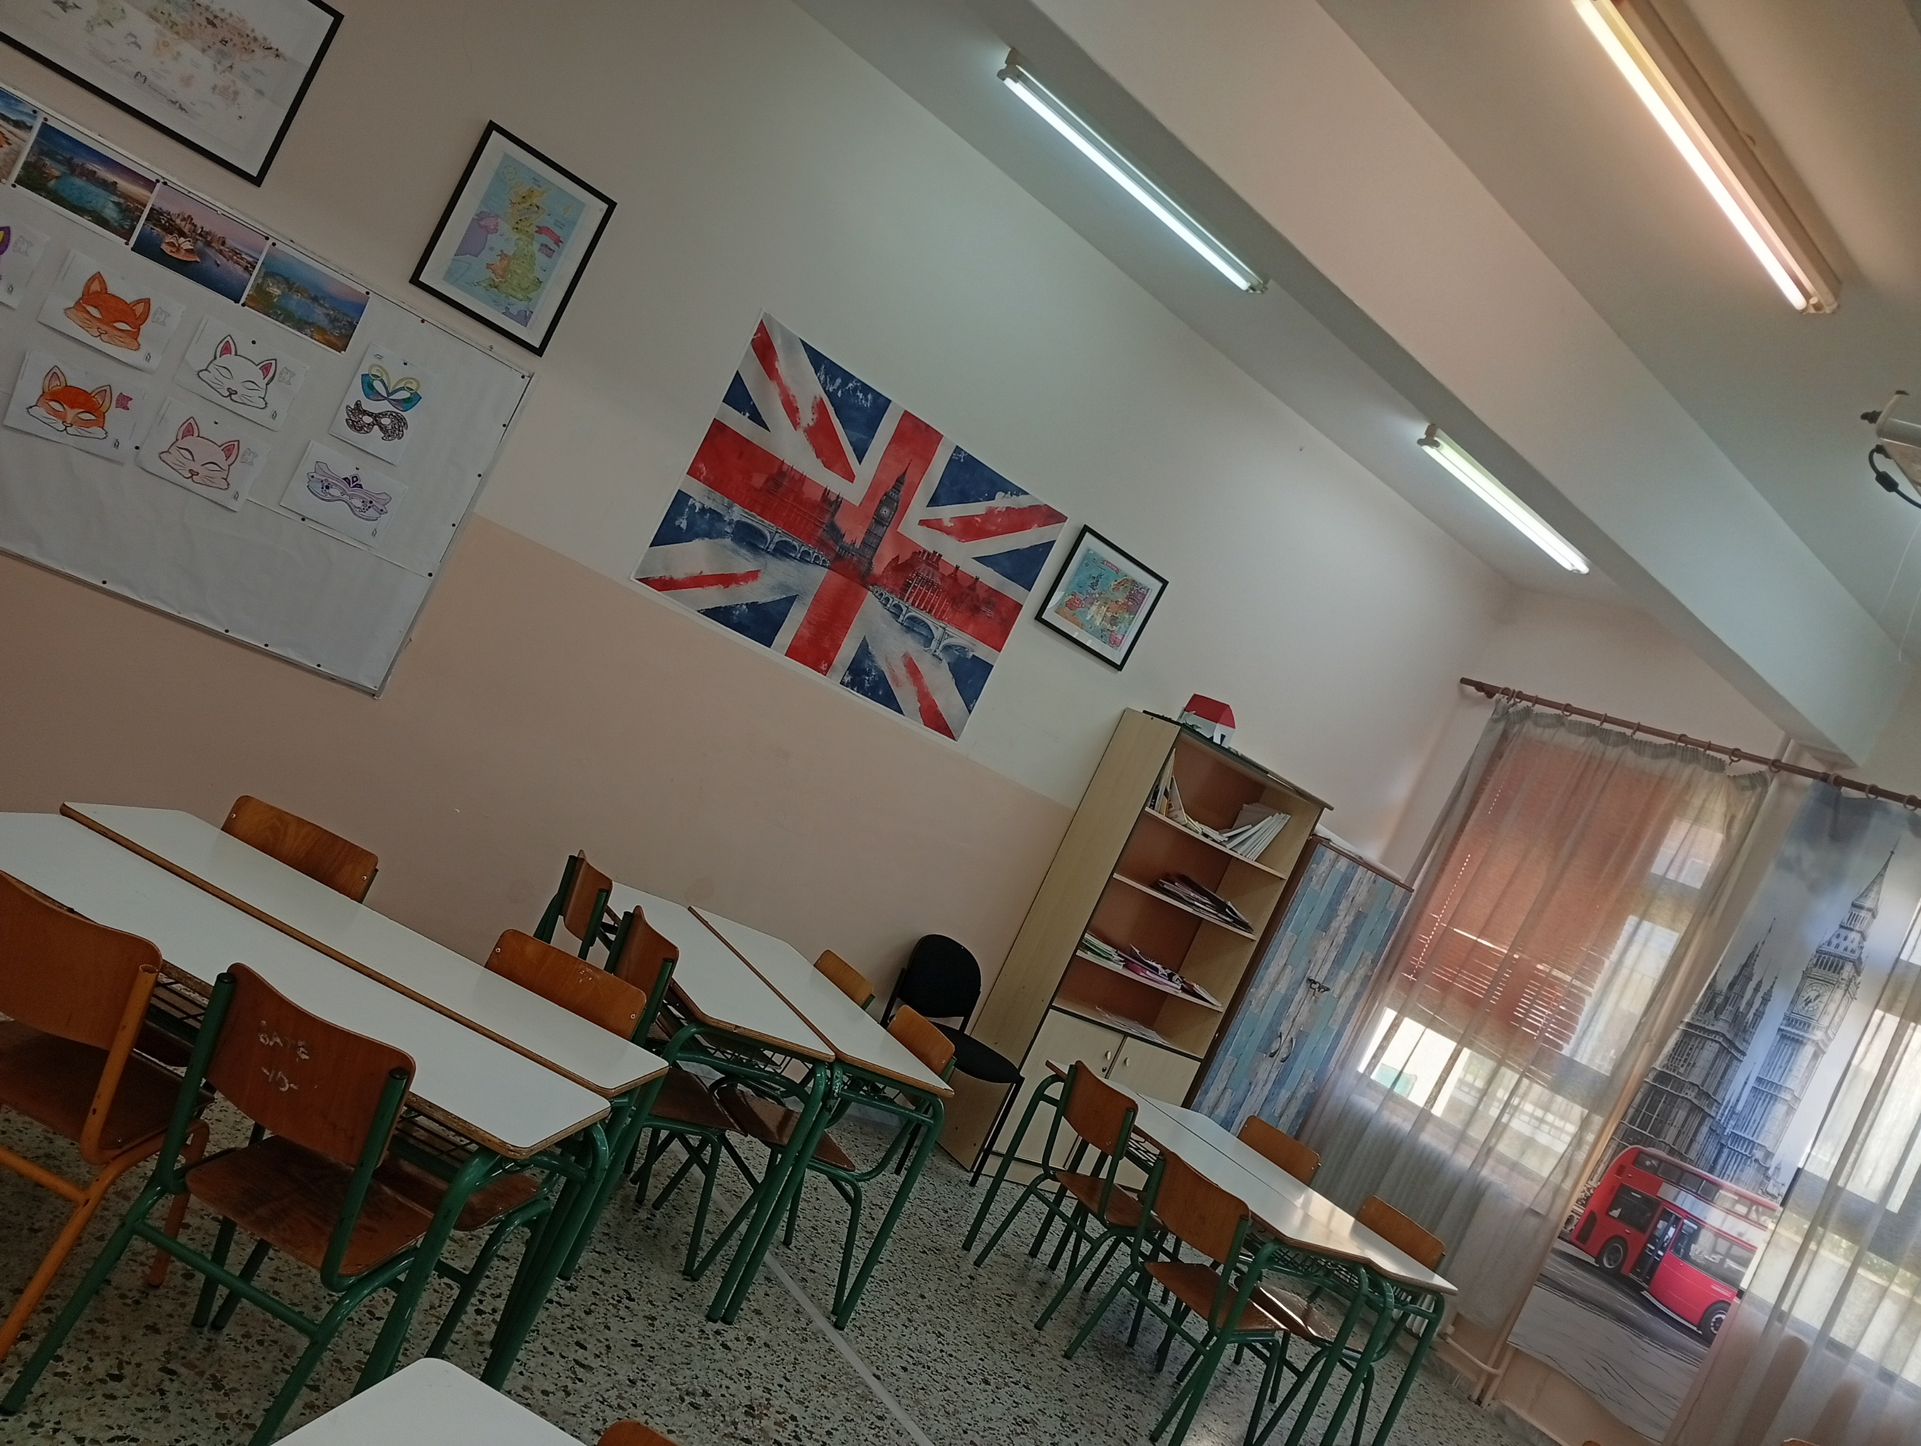

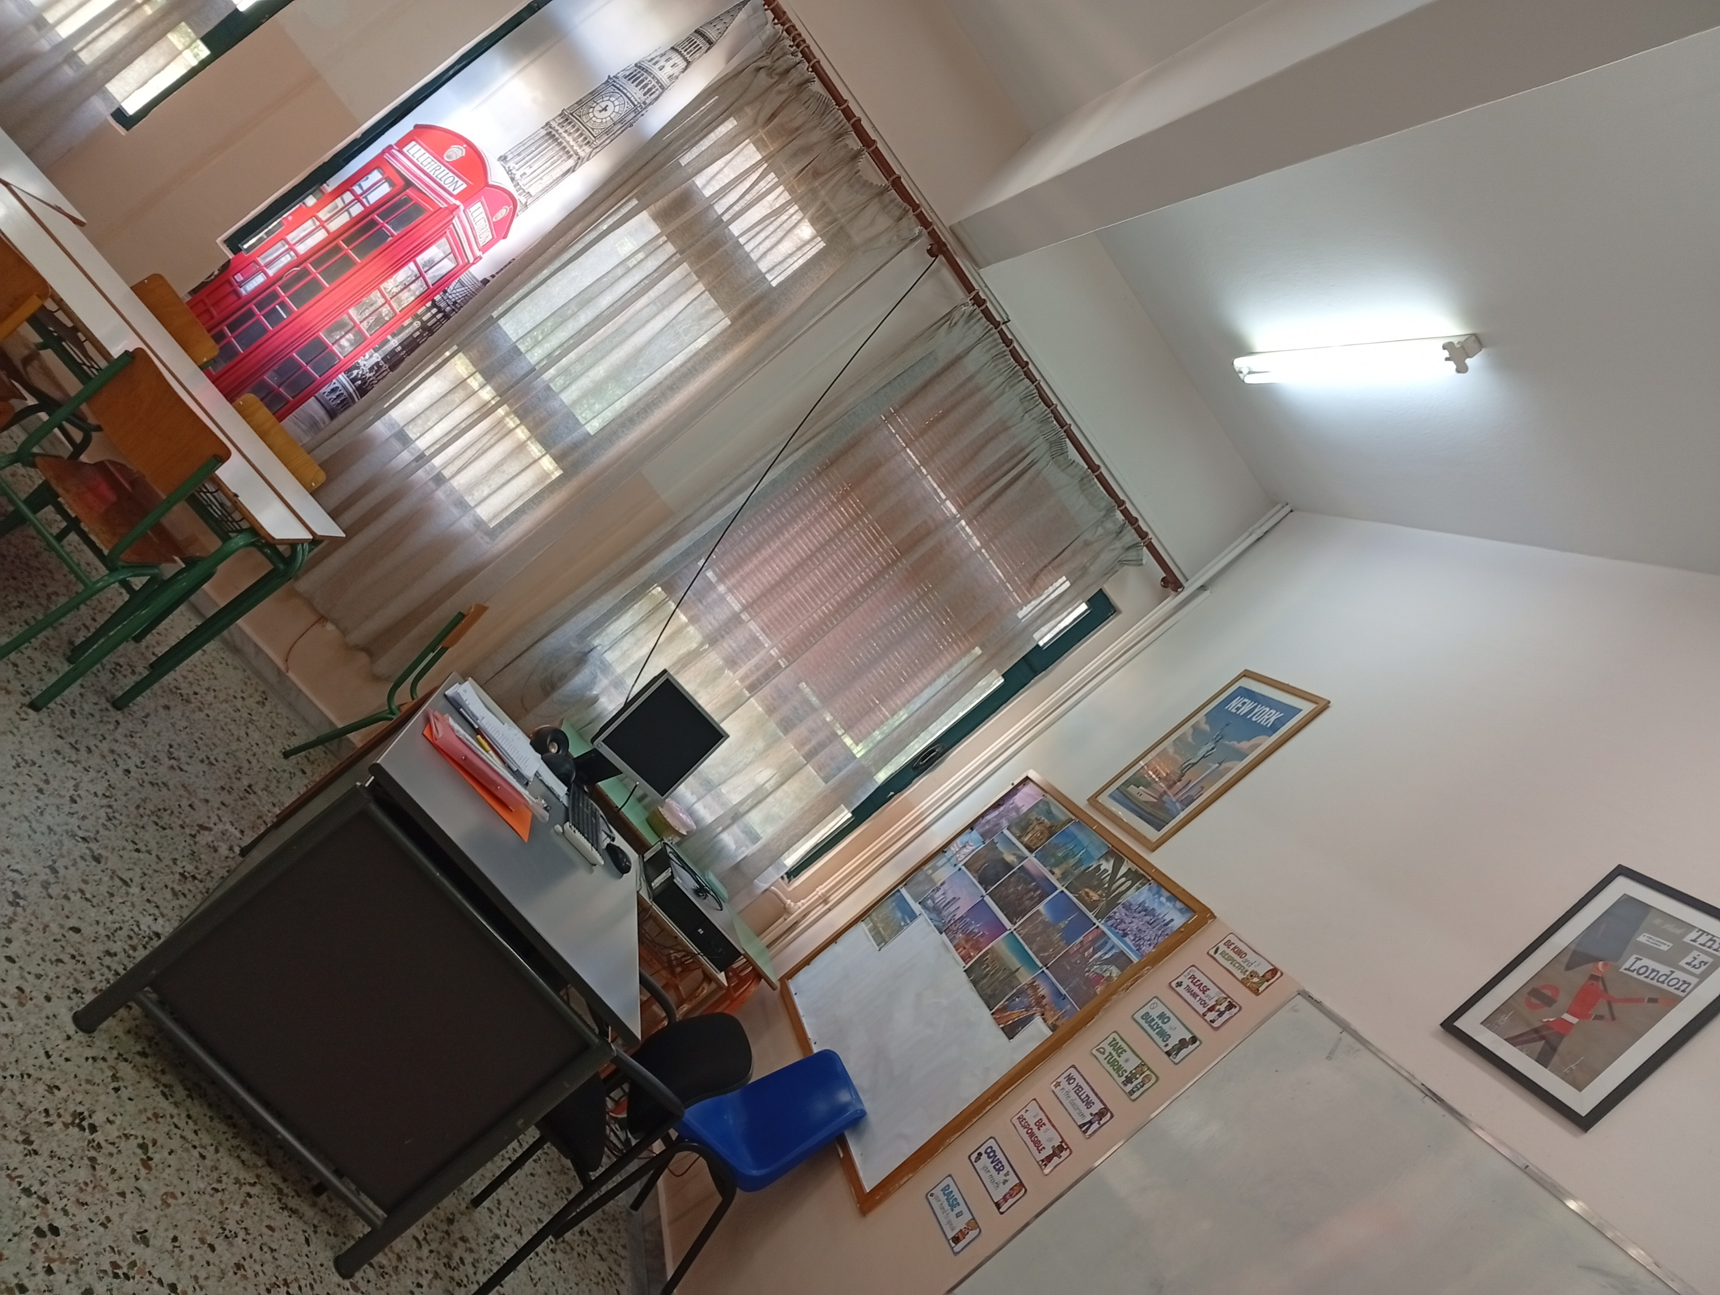
The English class

Slide 9
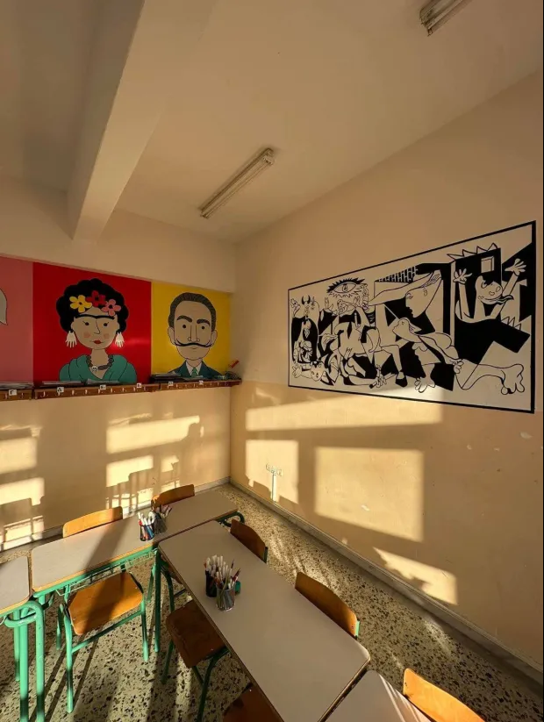
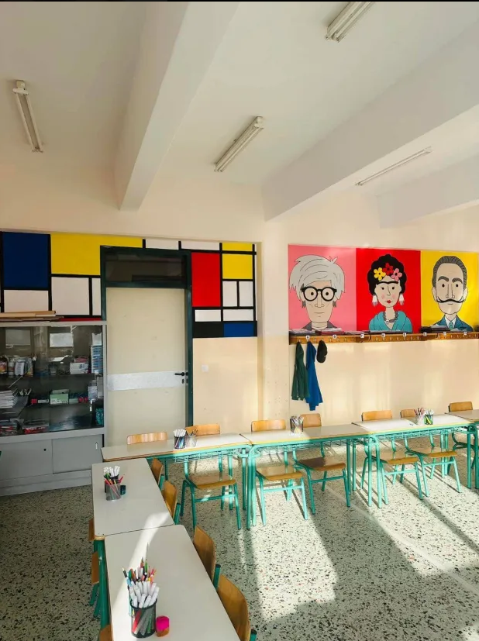
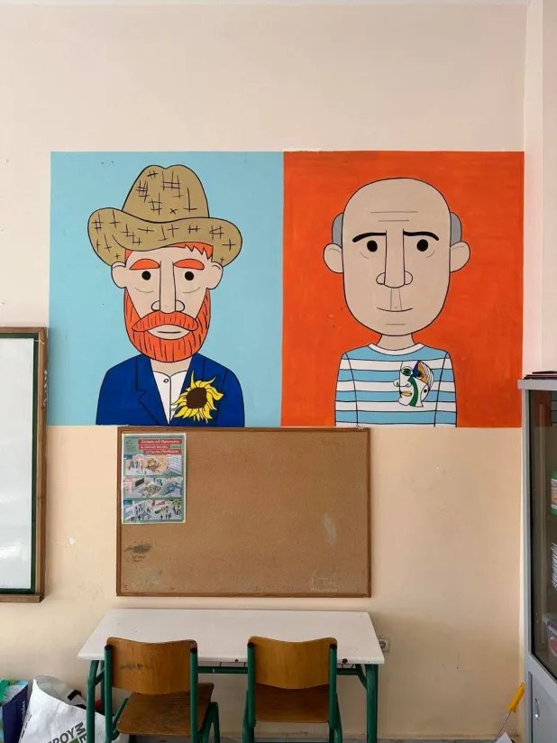
The art class

Slide 10
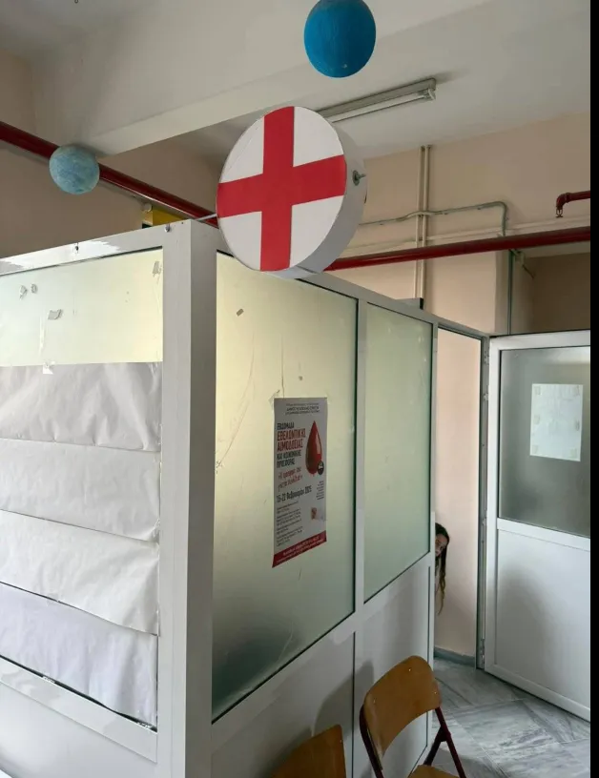
The nurse

Slide 11
Τηε εnd (this took so long oh my goodness)
Made by ian roditis
Huge thanks to my English teacher Ms Ierofili Bountoulousi, alias Ms Villy

